Slide 1

CROWD FUNDING ANALYSIS
Prepared by Group 3

Slide 2

Team Members – Group 3
Akansha Admane
Sai Mogarala
Bhavani Meesala
Kavya Shree B
Aman Sharma

Slide 3
INDEX
INTRODUCTION
.KPI-1 :Total Number of Projects based on outcome.
.KPI-2 : Total Number of Projects based on Locations.
.KPI-3 : Total Number of Projects based on Category.
.KPI-4 : Total Number of Projects created by Year , Quarter , Month.
* Successful Projects :
Amount Raised.
Number of Backers.
Avg Number of Days for successful projects.
* Top Successful Projects :
Based on Number of Backers.
Based on Amount Raised.
* Percentage of Successful Projects overall.
Percentage of Successful Projects by Category.
Percentage of Successful Projects by Year , Month.
Percentage of Successful projects by Goal Range.
.Excel Dashboard.
.SQL.
.power Bi Dashboard.
.Challenges faced.
.Conclusion.

Slide 4
INTRODUCTION
CROWD-FUNDING
Crowdfunding is a funding model where individuals (often through an online platform) can raise small amounts of money from a large number of people to fund projects, ventures, or causes. Unlike traditional financing, crowdfunding leverages the power of the crowd—engaging people around the world to support an idea or mission.

Slide 5
Project Outcomes: Analyzing the total number of projects based on their outcomes, locations, categories, and creation timelines (yearly, quarterly, and monthly).
Successful Project Metrics: We’ll dive into key indicators of successful projects, focusing on the amount raised, the number of backers, and the average time taken to reach success.
Top Performers: Highlighting the projects that gained the most traction, either by the number of backers or the funds raised.
Success Rates: Assessing the overall success rate across different categories, years, months, and fundraising goals to identify where projects are most likely to succeed.

Slide 6
Total number of projects based on outcomes
Special Recommendations:
> Showing case studies of successful projects to illustrate best practices and common traits among successful campaigns.
> Adding a metric in the presentation that quantifies success rates (e.g., success rate = Successful Projects / Total Projects). This can help investors and creators assess the chances of success.
> Stressing the importance of engaging with backers during the live phase through updates, interactions, and incentives to encourage higher backing and achieve funding goals.
>The total No. of projects based on outcome : 188239 FAILED.

Slide 7
Percentage of Successful projects by Goal Range
Special Recommendations :
> Building a strong online presence, engage with potential backers, and create hype through social media and influencer outreach.
> Offering tiered rewards, provide regular updates, and utilize paid advertising to reach a wider audience.
> Need to Ensure timely reward delivery, collect backer feedback, and maintain community engagement to build a loyal supporter base.
>The percentage of successful projects by Goal Range :93.18%

Slide 8
Percentage of Successful Projects by Year
Special Recommendations :
> Crafting a compelling project pitch with clear goals. Utilize high-quality visuals and videos. ensure project description is concise and engaging.
> Identifying potential risks and develop contingency plans. communicate risks and challenges transparently. mitigate risks through proactive planning.
> Assembling a diverse and skilled project team. define roles and responsibilities clearly. ensure effective communication.
>The percentage of successful projects by year :2014 value :13.73%

Slide 9
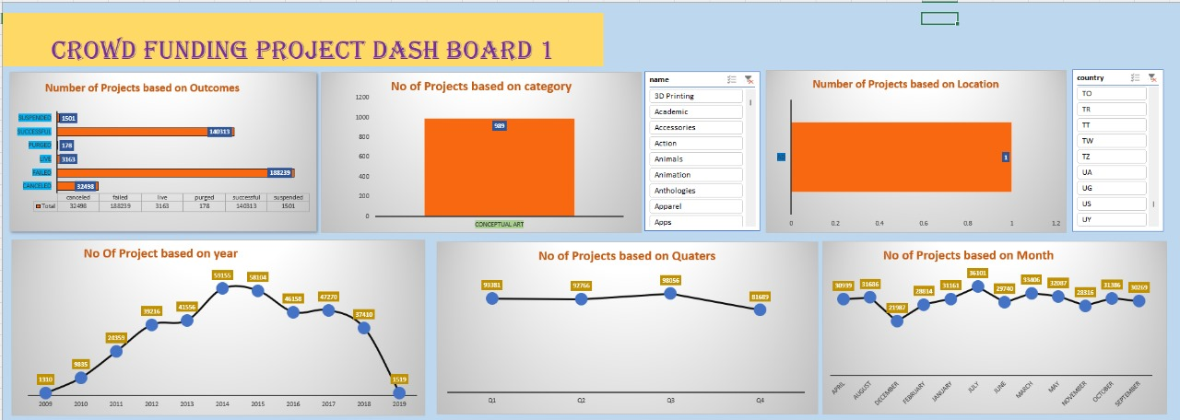
Dashboard For EXCEL

Slide 10
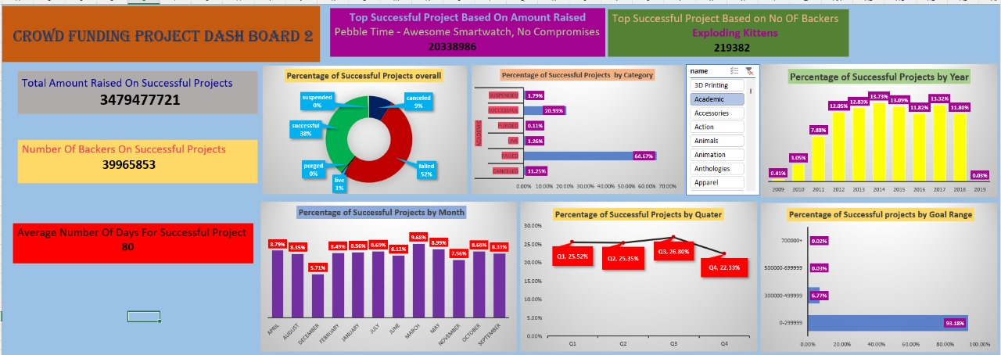
Dashboard For EXCEL

Slide 11
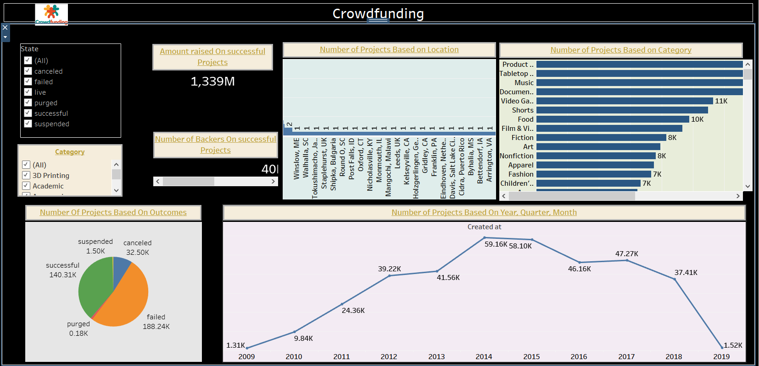
Tableau Dashboard

Slide 12
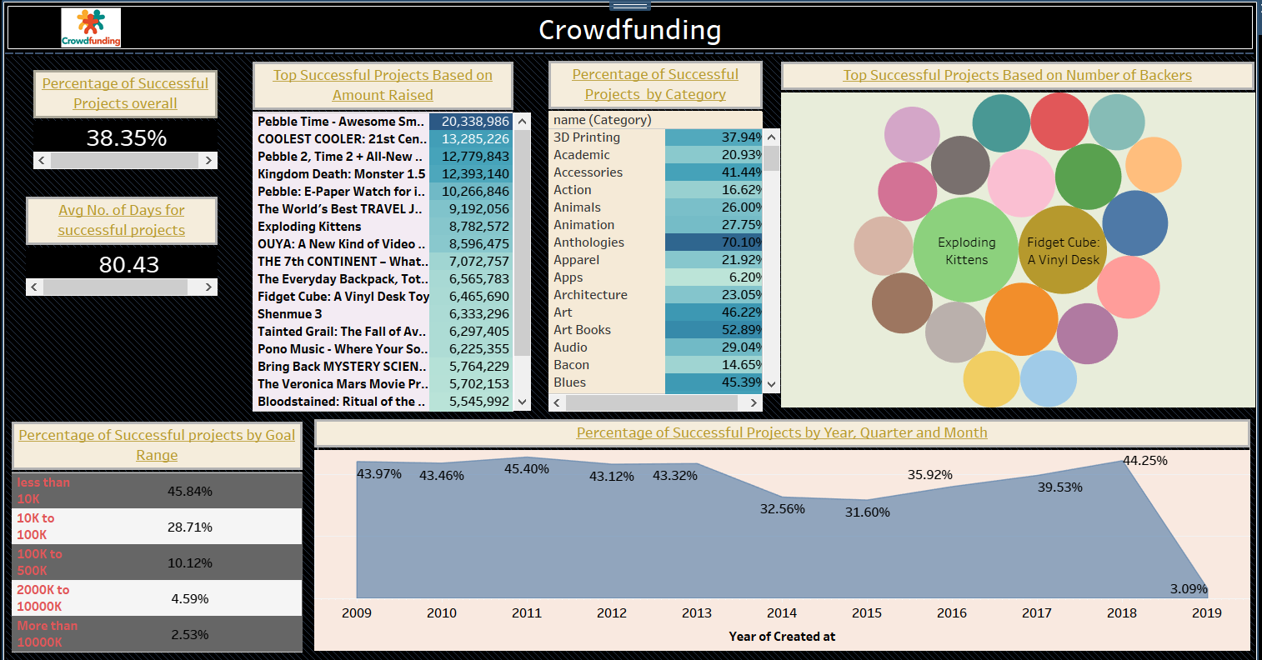
Tableau Dashboard

Slide 13
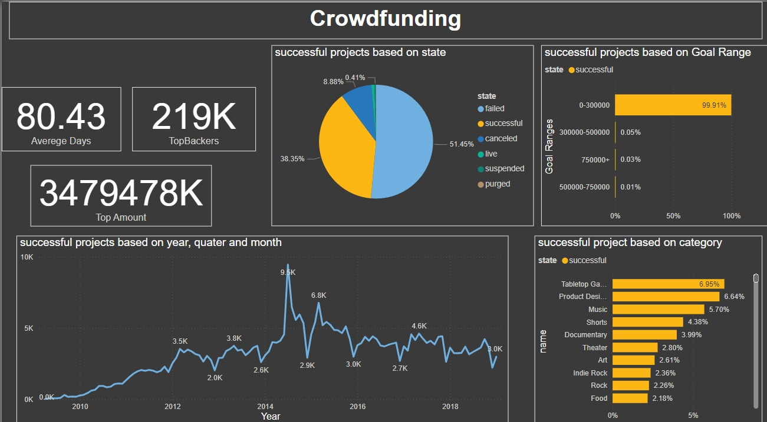
Power BI Dashboard

Slide 14
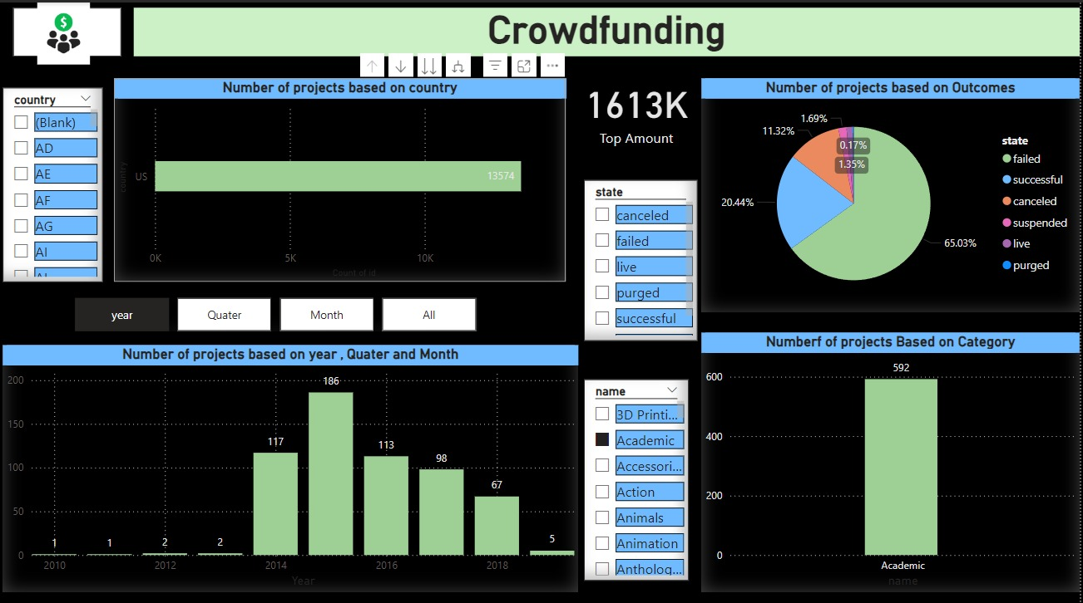
Power BI Dashboard

Slide 15
CHALLENGES FACED DURING THE PROJECT
Managing social media and marketing efforts
Handling project scalability and growth
Managing backer expectations and communication
Meeting funding targets and managing budget constraints

Slide 16
CONCLISION
1 >Staying up-to-date with industry trends and best practices.
2 >Defining a clear project scope and realistic funding goals.
3 >Engaging with backers and maintain open communication.
4 >Building a strong community and maintaining transparency are key.
5 >Offer attractive rewards and incentives.

Slide 17


